Slide 1
Architecture: Building Blocks, Real-Time Issues, and Schedulability
Mike Whalen
University of Minnesota Software Engineering Center
Andrew Gacek, John Backes, Darren Cofer
Rockwell Collins Advanced Technology Center

Slide 2
Overview of Topics
Building from AADL
Active and Passive Tasking Model
Minor Interface Changes
Schedulability Analysis
“Headless” OSATE build
Testing and Integration

Slide 3
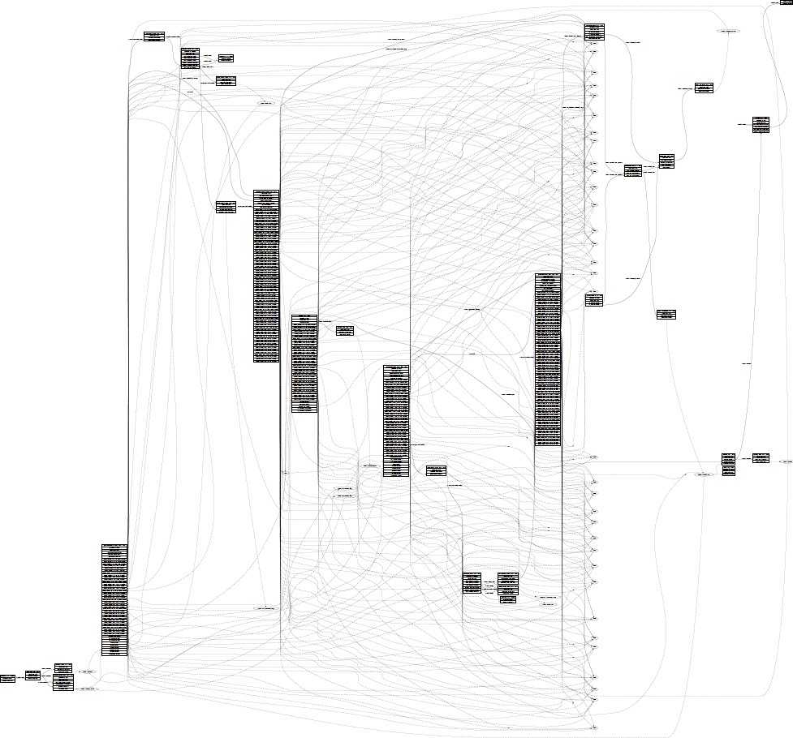
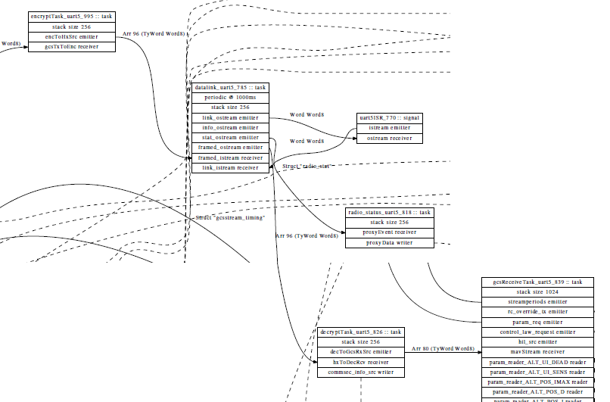
Datalink
Radio UART
GCS Receive
Decrypt

Slide 4
Phase I Architecture
Pros: Good Functional Design Principles
Small, cohesive tasks
Low coupling via message passing
Cons: Analysis
Schedulability
Internal-event scheduled processes do not have bounded min-dispatch times
Large numbers of OS-scheduled processes make RTOS context switch slow
Latency
Bounding end-to-end time for information to flow through the system?
Significant possible jitter if priorities are mis-aligned
Behavioral Analysis:
Interleavings and queueing behavior causes state explosion for automated analysis tools

Slide 5
An Example
A
C
E
Periodic: 100ms
B
D
A
F
Sporadic: IRQ with min dispatch interval: 1ms
Six tasks: {A, B, C, D, E, F}
Tasks communicate using event ports that send messages
Also communicate using shared variables, but these do not cause dispatch

Slide 6
Phase 1 Approach
Thread 1
Thread 2
Thread 3
A
C
E
Periodic: 100ms
Aperiodic
Aperiodic
Thread 4
Thread 5
Thread 6
B
D
A
F
Sporadic: IRQ with min dispatch interval: 10 ms
Aperiodic
Aperiodic
Lots of queueing
Lots of asynchrony
No deadlock though livelock is possible
Assigning priorities is tricky and can lead to jitter
Aperiodic threads are difficult to schedule

Slide 7
Phase II Architectural Principles
Preserve “good” cohesion and coupling
This is really nice in Phase I!
Provide better analysis support
Schedulability analysis using std. approaches
RMA or EDF
Mechanisms for measuring flow latency / jitter
Reduce asynchrony for scalable behavioral analysis

Slide 8
Phase 2 Approach
A
C
E
T1
Periodic: 100ms
Passive
Passive
B
D
A
F
T2
Sporadic: IRQ with min dispatch interval: 1 ms
Passive
Passive
Passive tasks are Hoare-style monitors
Communication to passive tasks: synchronous calls
Fewer OS-scheduled threads / less asynchrony

Slide 9
Phase 2 Approach
A
C
E
T1
Periodic: 100ms
Passive
Passive
B
D
A
F
T2
Sporadic: IRQ with min dispatch interval: 1 ms
Passive
Passive
Communication to active tasks: queued as in Phase I
Possibility of Deadlock!

Slide 10
Phase 2 with RPCs
A
C
E
T1
Periodic: 100ms
Passive
Passive
B
D
A
F
T2
Sporadic: IRQ with min dispatch interval: 1 ms
Passive
Passive
Want to avoid deadlock and minimize resource contention
Naïve approach: Standard RPCs
Resource contention length is sum of WCETs of longest contention chain
Deadlock possible if circular communications between threads

Slide 11
Phase 2 with Queued RPCs
A
C
E
T1
Periodic: 100ms
Passive
Passive
B
D
A
F
T2
Sporadic: IRQ with min dispatch interval: 1 ms
Passive
Passive
Want to avoid deadlock and minimize resource contention
Queued RPCs: Queue events until monitor complete and semaphore released
Resource contention is then WCET of single monitor

Slide 12
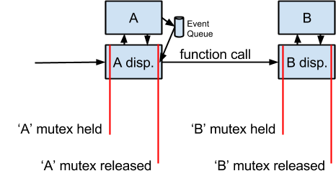
Queued RPCs

Slide 13

Visualizing an Execution Sequence
A
C
E
T1
Periodic: 100ms
Passive
Passive
B
D
A
F
T2
Sporadic: IRQ with min dispatch interval: 1 ms
Passive
Passive
Want to avoid deadlock and minimize resource contention
Queue events until monitor complete
Resource contention is then WCET of single monitor

Slide 14
Schedulability Analysis with RMS
A
C
E
T1
1
2
1
Periodic: 100ms
WCET: 50us
Passive
WCET: 1ms
1
Passive
WCET: 1 ms
OS Task Switch:
10us
B
D
A
F
T2
1
1
Sporadic: IRQ with min dispatch interval: 1 ms
WCET: 50us
Passive
WCET: 20us
Passive
WCET: 200us
From component writers, we need:
maximum number of outgoing events per port per task dispatch
WCET for each task
Dispatch type and min-interval for active threads
Maximum time / dispatch rate for First Level Interrupt Handlers
From OS, we need:
Task switch time (preemption overhead)
Mutex lock time

Slide 15
Schedulability Analysis with RMS
A
C
E
T1
1
2
1
Periodic: 100ms
WCET: 50us
Passive
WCET: 1ms
1
Passive
WCET: 1 ms
OS Task Switch:
10us
B
D
A
F
T2
1
1
Sporadic: IRQ with min dispatch interval: 1 ms
WCET: 50us
Passive
WCET: 20us
Passive
WCET: 200us
Thread 1 has low priority. T1 WCET: 100us + 1ms + 2*(1 ms + 20us + 200us) + 20us + 200us = 3760us
Thread 2 has high priority. T2 WCET: 50us + 20us + 200us = 270us
Maximum blocking time for thread 1: execution of Task F (200us)
+ time for context switches + mutex lock/unlock

Slide 16
Latency Analysis
A
C
E
T1
1
2
1
Periodic: 100ms
WCET: 50us
Passive
WCET: 1ms
1
Passive
WCET: 1 ms
OS Task Switch:
10us
B
D
A
F
T2
1
1
Sporadic: IRQ with min dispatch interval: 1 ms
WCET: 50us
Passive
WCET: 20us
Passive
WCET: 200us
If on one thread (active task), can be computed from WCET
If crossing multiple threads, can be bounded (future work)

Slide 17
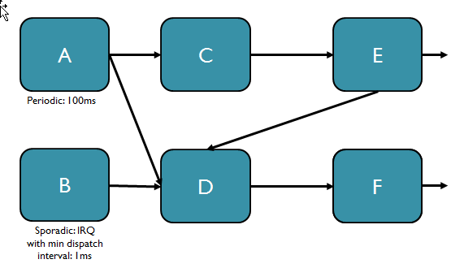
AADL Properties for Build
thread E
features
Input1: in event data port Base_Types::Unsigned_32 {
SMACCM_SYS::CommPrim_Source_Header => "E_Handlers.h";
SMACCM_SYS::CommPrim_Source_Text => "E_Handlers.c";
SMACCM_SYS::Compute_Entrypoint_Source_Text =>
("eventhandler_E_Input1");
};
Output1: out event data port Base_Types:: Unsigned_32 {
SMACCM_SYS::CommPrim_Source_Header => "E_Output.h";
SMACCM_SYS::CommPrim_Source_Text => "E_Output";
};
Output2: out data port Base_Types:: Unsigned_32 {
SMACCM_SYS::CommPrim_Source_Header => "E_Output.h";
SMACCM_SYS::CommPrim_Source_Text => "E_Output";
};
properties
SMACCM_SYS::Language => "Ivory";
SMACCM_SYS::Thread_Type => Passive ;
Compute_Execution_Time => 5 us .. 30 us;
SMACCM_SYS::Sends_Events_To => "{{1 Output1, 1 Output2}, {2 Output 2}}";
end E ;
Thread Type: Active or Passive
Compute_Execution_Time: BCET .. WCET
Sends_Events_To:
List of sets of comma separated {<number> <port>} pairs
In this case, the thread can send one message to each of Output1 and Output2, or two messages to Output2

Slide 18
AADL Properties for Build
thread A
features
Output1: out event data port Base_Types:: Unsigned_32 {
SMACCM_SYS::CommPrim_Source_Header => "A_Output1.h";
SMACCM_SYS::CommPrim_Source_Text => "A_Output1";
};
Output2: out event data port Base_Types:: Unsigned_32 {
SMACCM_SYS::CommPrim_Source_Header => "A_Output2.h";
SMACCM_SYS::CommPrim_Source_Text => "A_Output2";
};
properties
Dispatch_Protocol => Periodic;
Period => 100 ms;
Source_Text => ("eventhandler_periodic_A.c");
Priority => 45;
Stack_Size => 2048 bytes;
SMACCM_SYS::Language => "Ivory";
SMACCM_SYS::Thread_Type => Active ;
Compute_Execution_Time => 10 us .. 50 us;
SMACCM_SYS::Sends_Events_To => "{{1 Output1, 1 Output2}}";
end A ;
Active threads have a dispatch protocol: Periodic or Sporadic (for event-based threads). If periodic, then a period must be specified
Active threads must have a specified stack size. This is currently the aggregate required stack for all passive object invocations; we could modify this so that it is computed from stack sizes of each passive object.

Slide 19
Implementations
eChronos:
All tasks in one memory space
Implementation: procedure calls with mutex for mutual exclusion
Sends_Events_To property used to determine maximum queue depth for each outgoing interface.
Queued communications same as Phase I
CAmkES
Tasks in separate memory spaces
Active/passive tasks correspond closely to CAmkES active/passive components
However, to support queued synchronous calls, scheduler component is constructed for each thread to actually perform dispatching to tasks

Slide 20
AADL → CAmkES Overview
All threads (active or passive) become components
data ports in AADL become dataports of the same type.
Need mutual exclusion for complex types.
Event/event data ports become:
If destination is active thread: dataport containing queue for destination (matching Phase I eChronos)
If destination is passive thread: RPC interface with message as argument.
AADL RPC ports are translated into CAmkES procedures (for interface) and uses/consumes.
Priorities are described in the configuration

Slide 21
CAmkES Implementation
AADL Model:
thread A
features
Output1: out event data port Base_Types:: Unsigned_32 {
SMACCM_SYS::CommPrim_Source_Header => "A_Output1.h";
SMACCM_SYS::CommPrim_Source_Text => "A_Output1";
};
Output2: out event data port Base_Types:: Unsigned_32 {
SMACCM_SYS::CommPrim_Source_Header => "A_Output2.h";
SMACCM_SYS::CommPrim_Source_Text => "A_Output2";
};
properties
Dispatch_Protocol => Periodic;
Period => 100 ms;
SMACCM_SYS::Compute_Entrypoint_Source_Text =>
("eventhandler_periodic_A1”, "eventhandler_periodic_A2”,);
… more stuff here
end A ;
CAmkES component:
component A {
control;
uses Unsigned_32_Receiver A_Output1;
uses Unsigned_32_Receiver A_Output2;
consumes sig sig_period;
dataport buffer b2;
}
CAmkES interface:
CAmkES config:
Generated C code
procedure Unsigned_32_Receiver {
void the_proc(in int arg);
}
I don’t know how to do this yet!!
- Priority
- Stack Size
- Setting up interaction with system resources (timer interrupt)
- Binding C code into make
void main() {
uint32 time = get_system_time();
eventhandler_periodic_A1(time);
eventhandler_periodic_A2(time);
}

Slide 22
CAmkES Implementation Qs
Tower parameter passing conventions vs. CAmkES parameter passing conventions
AADL generation matches Tower
How should we set up periodic task dispatch?
Dispatcher as signaler:
All periodic tasks are control components
Dispatcher signals each periodic task at appropriate time
Matches eChronos model
Dispatcher as executor:
All periodic tasks are passive components
Dispatcher executes tasks sequentially based on periodic argument
Send/Receive primitives between threads in CAmkES
Can we send complex types?
Can we specify queues with certain depth?

Slide 23
Build Mechanics
Headless version of aadl2rtos for Eclipse using RAMSES
“Standard” headless build tool for OSATE
Supports command line build
Like to integrate into Phase I build
For eChronos: added support for two-level interrupt handlers and multiple ISRs per thread:
Input1: in event data port Base_Types::Integer {
SMACCM_SYS::CommPrim_Source_Header => "Signal1_Handlers.h";
SMACCM_SYS::CommPrim_Source_Text => "Signal1_Handlers.c";
SMACCM_SYS::Is_ISR => true;
SMACCM_SYS::Signal_Name => "signal1";
SMACCM_SYS::First_Level_Interrupt_Handler => "flih_signal1";
SMACCM_SYS::Compute_Entrypoint_Source_Text => ("eventhandler_signal1_1, eventhandler_signal1_2");
};

Slide 24
Issues
Stack usage: deep passive task chains lead to large stack requirements for active threads
On the other hand, we get rid of most input queues
Similar “global” memory requirements
Migration of use from static segment to stack
Response time vs. # of active processes
May want periodic processes immediately following “fast”
Direct support for RPCs
Easy on CAmkES. Necessary for eChronos?
Getting to system services in CAmkES
Mutexes for active thread communications
Drivers or direct access to ISRs
CAN bus(!)
Critical and non-critical tasks and priorities

Slide 25
Questions?

